Slide 1
Keyboard Interfacing-8051

Slide 2
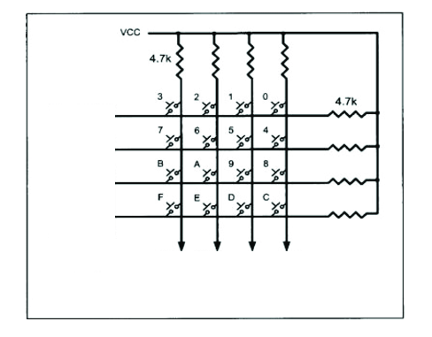
A keyboard is nothing but a bunch of switches arranged in a particular fashion.
The following is a 4*4 matrix key board.
Here the switches are arranged in optimized manner to minimize the port pins.
Junction of each row and column forms the key.

Slide 3
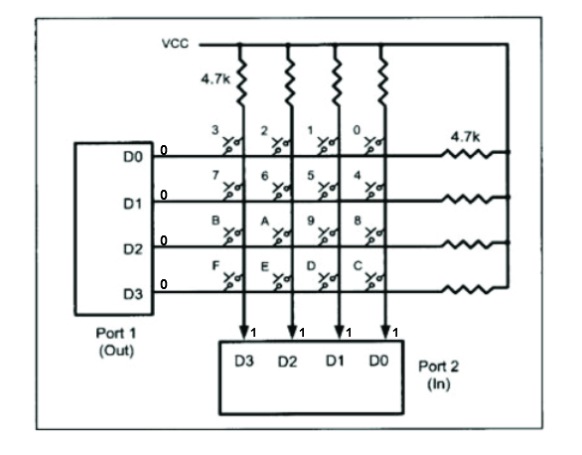
To interface the keyboard 8051 uses two of its ports.
The port which is connected to the rows of the matrix is configured as an output port, hence making each row logic 0.
The port which is connected to the columns is configured as an input port, making the column at logic 1.

Slide 4
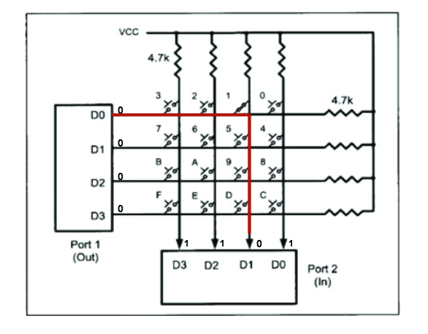
Key Press Detection
Step 1: Key Press identification
-Check the value of the columns(D0-D3 of input port).
-If D0-D3=1111, no key has been pressed.
continue this process until a key press is detected.
If one of the column bit is 0, then a key has been pressed.
Suppose D0D1D2D3=1011, D1 has been pressed.

Slide 5
Step 2: Key Detection
-Check the values of row(D0-D3 of output port)
-Read the row one by one,
-Starting with the top row, the microcontroller grounds it by providing a low to row D0 only.
-Reads the columns, if all the values are 1s, no key is activated in that row.
-the process is moved to the next row
-The process is continued until the row is identified.
-After identification of the row, it identifies the column that the pressed key belongs to.

Slide 6
Issues
Debouncing:
The output of a switch at open and close is very, very noisy with multiple spikes in voltage. If not correctly debounced, these spikes could be seen as multiple switch closures (openings).
The main job of any switch is to connect two terminals to complete a circuit but this process is not instantaneous, that means it takes some time for the switch to complete the circuit.
Due to this, the signal to the microcontroller is noisy until the contacts of the switch make proper contact with the underlying wires.
this problem can be solved
      using capacitors and Schmitt triggers
      using software approach
To solve this problem, the microcontroller needs to wait for a certain amount of time and allow the signal to stabilize.

Slide 7
Making sure the previous key has been released:
The microcontroller needs to start scanning the matrix after a key press has been detected.
To do this, the microcontroller must make all the rows logic zero and see if all the columns have a logic 1.
If all the columns have logic 1, it means that none of the keys are pressed, and the microcontroller needs to look for a new keypress.
Encoding the keypress:
Also it is essential to convert the information about the keypress into information that can be shown on an LCD or any other output peripheral for that matter.

Slide 8
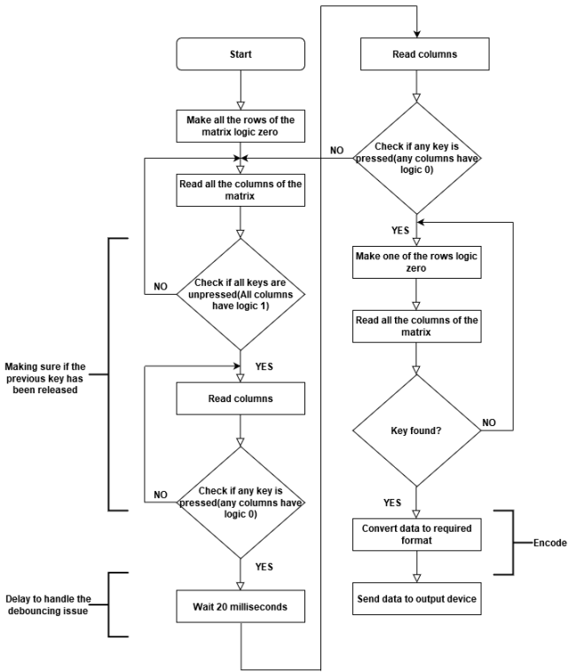

Slide 9
